Slide 1




Slide 2
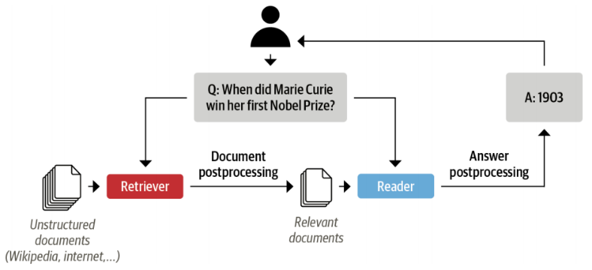
In the last Video
Simple Answer Extraction
Problem: selecting relevant passages from all the reviews in our corpus.
Solution: concatenate all the reviews of a given product together and feed them to the model.
The drawback: the context can become extremely long → unacceptable latency for our users’ queries.
Question
QA Model
Answer
Context
Reality QA System

Slide 3
QA systems based on the retriever-reader architecture
Notes:
Hello and welcome, in this video we will start to dive into the components of the internal structure of transformers.

Slide 4
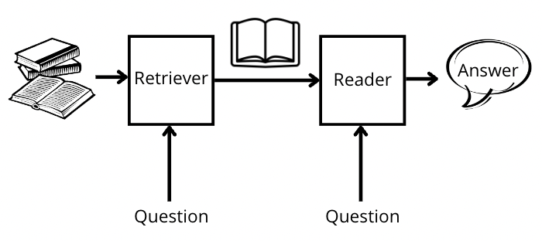
Introduction
The Retriever: retrieving relevant documents for a given query.
The Reader: extracting an answer from the documents provided by the retriever.

Slide 5
Retrievers Types
Sparse retrievers:
use word frequencies to represent each document and query as a sparse vector.
The relevance of a query and a document → by computing an inner product of the vectors.
Dense retrievers:
use encoders like transformers to represent the query and document as contextualized embeddings (dense vectors).
These embeddings encode semantic meaning and allow dense retrievers to improve search accuracy by understanding the content of the query.

Slide 6

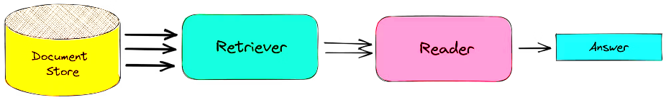
Haystack library
Haystack is based on the retriever-reader architecture.
Component of building a QA pipeline with Haystack:
The retriever
The reader
Document store: A document-oriented database that stores documents and metadata.
Pipeline: Combines all the components of a QA system to enable custom query flows, merging documents from multiple retrievers.

Slide 7
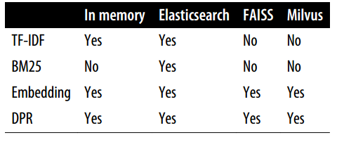

What’s Document store?
In Haystack, there are various document stores:
InMemoryDocumentStore.
ElasticsearchDocumentStore.
ElasticsearchDocumentStore, which is compatible with both retriever types.
Sparse retrievers
Dense retrievers

Slide 8
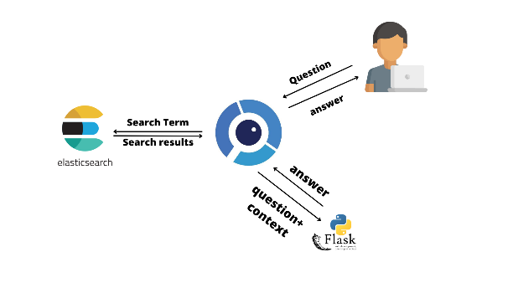
What’s Elasticsearch?
Elasticsearch is a search engine that is capable of handling a diverse range of data types including textual, numerical, geospatial, structured, and unstructured
Advantage of Elasticsearch
Store huge volumes of data
Quickly filter it with full-text search features
well-suited for developing QA systems.
Being the industry standard for infrastructure analytics.

Slide 9
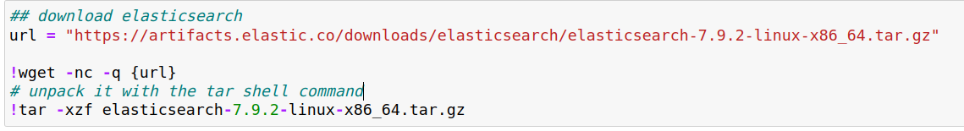
Initializing a document store
Download and install Elasticsearch:

Slide 10
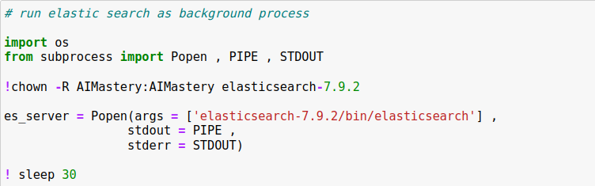
Initializing a document store
Download and install Elasticsearch.
1. Start the Elasticsearch server:
Popen() function to spawn a new process
The chown shell command run the subprocess in the background.
In the Popen function args:
stdout=PIPE creates a new pipe for the standard output.
stderr=STDOUT collects the errors in the same pipe.

Slide 11
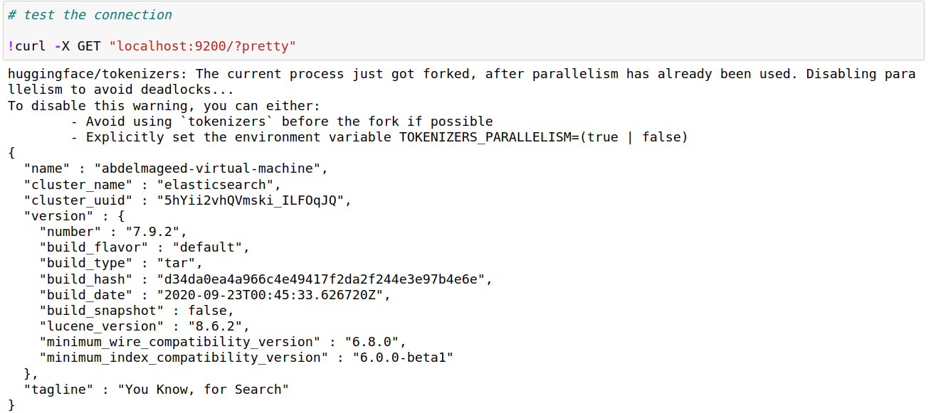
Initializing a document store
2. Test the connection by sending an HTTP request to localhost.

Slide 12
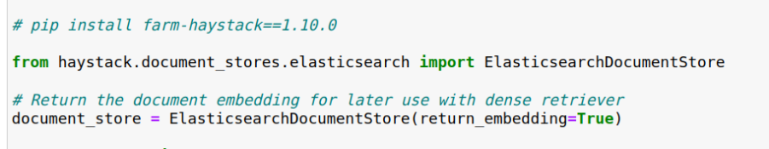
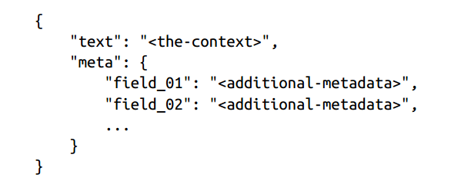
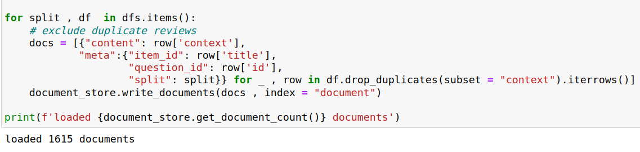
Initializing a document store
3. Instantiate the document store.
ElasticsearchDocumentStore creates two indices on Elasticsearch:
Document: storing documents
Label: storing the annotated answer spans
4. Applying filters during retrieval:

Slide 13
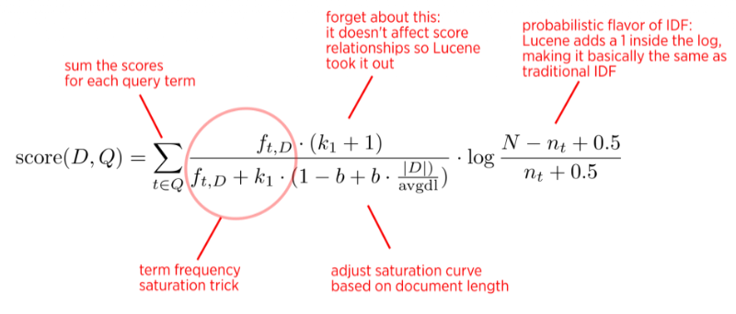
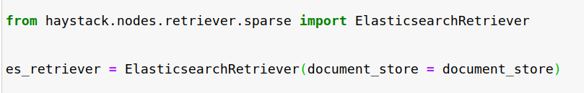
Initializing a retriever
ElasticsearchDocumentStore can be paired with any of the Haystack retrievers.
Using a sparse retriever based on Best Match 25(BM25):
BM25 is an improved version of the classic TF-IDF algorithm
the question and context are represented as sparse vectors.
How BM25 works?
The BM25 score quantifies the relevance of matched text to a search query.
TF-IDF by rapidly reaching saturation with TF values and normalizing for document length.
Preference to shorter documents over longer ones.

Slide 14
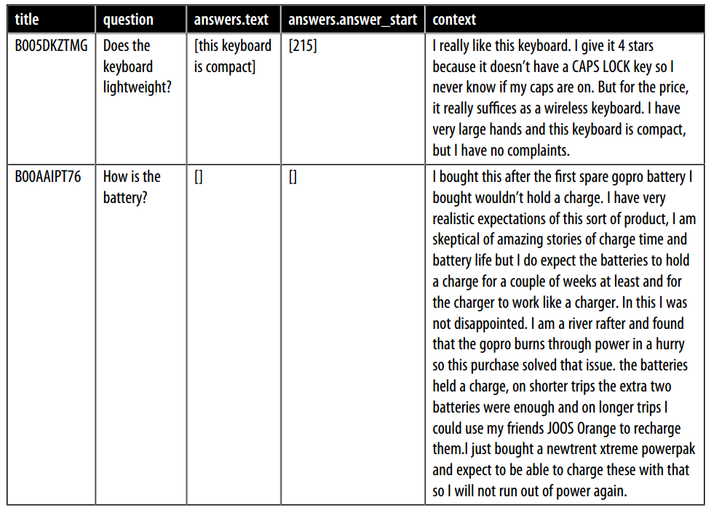


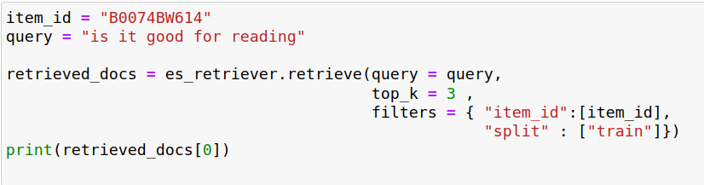
Why filtering is important?
It’s important to restrict the queries to a single item.
The query: Is the camera quality any good?”
BOOAAIPT76
B005DKZTMG

Slide 15
Why filtering is important?
The score that Elasticsearch computed for its relevance to the query:
Filter the candidate documents by applying a Boolean test.
Apply a similarity metric → representing both the document and the query as vectors.
<Document: {'content': 'This is a gift to myself. I have been a kindle user for 4 years and this is my third one. I never thought I would want a fire for I mainly use it for book reading. I decided to try the fire for when I travel I take my laptop, my phone and my iPod classic. I love my iPod but watching movies on the plane with it can be challenging because it is so small. Laptops battery life is not as good as the Kindle. So the Fire combines for me what I needed all three to do. So far so good.', 'content_type': 'text', 'score': 0.6857824513476455, 'meta': {'item_id': 'B0074BW614', 'question_id': '868e311275e26dbafe5af70774a300f3', 'split': 'train'}, 'embedding': None, 'id': '252e83e25d52df7311d597dc89eef9f6'}>

Slide 16
Reader types
1- FARMReader
Based on Deepset’s FARM framework for fine-tuning and deploying transformers.
Compatible with models trained using Transformers.
2- TransformersReader
Based on the QA pipeline from Transformers.
Suitable for running inference only.
Differences in the way the predictions are converted to produce answers:
In Transformers:
Normalizes the start and end logits with a SoftMax in each passage → only meaningful to compare answer scores.
For example, an answer score of 0.9 from one passage is not necessarily better than a score of 0.8 in another.
Sometimes predicts the same answer twice, but with different scores → in long contexts if the answer lies across two overlapping windows.
In FARM:
The logits are not normalized, so inter-passage answers can be compared more easily.
These duplicates are removed.

Slide 17
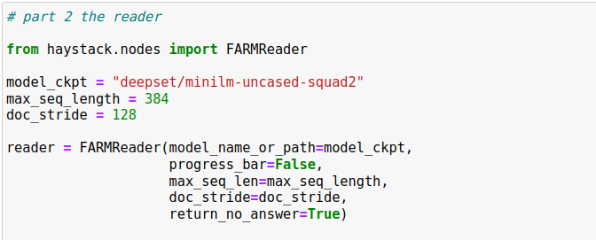
Initializing a reader

Slide 18
Initializing a reader

Slide 19

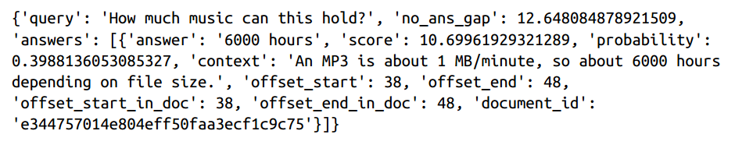
Initializing a reader
Test the reader:

Slide 20
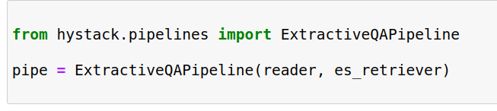
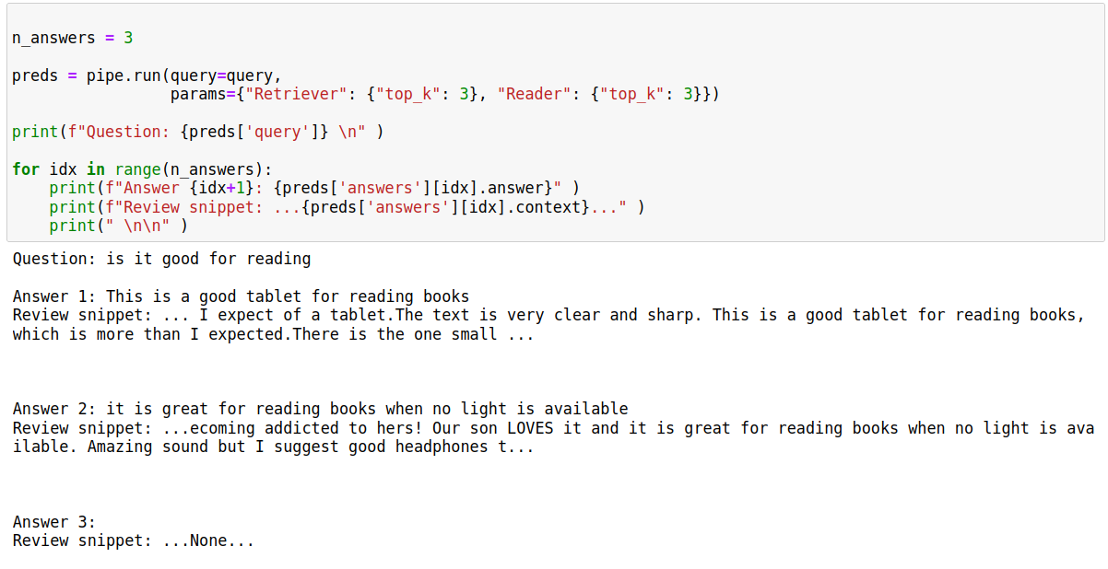
Putting it all together
Haystack Pipeline: provides an abstraction that allows us to combine retrievers, readers, and other components as a graph.

Slide 21
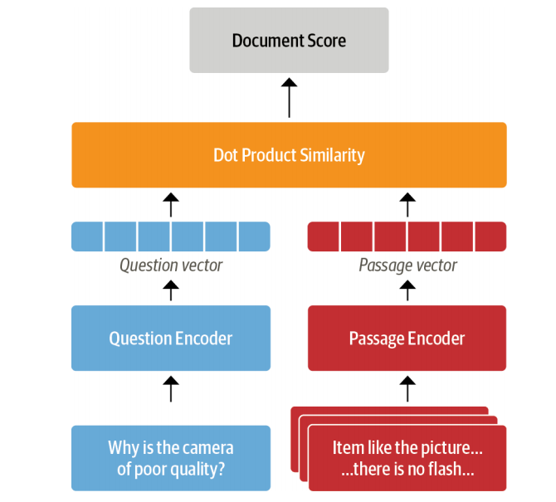
Dense Passage Retrieval (DPR)
Limitation of sparse retrievers like BM25
Can fail to capture the relevant documents → if the user query contains terms that don’t match exactly those of the review.
Dense embeddings → Dense Passage Retrieval (DPR):
The main idea behind DPR is to use two BERT models as encoders for the question and the passage.
These encoders map the input text into a d-dimensional vector representation of the Classification token.

Slide 22
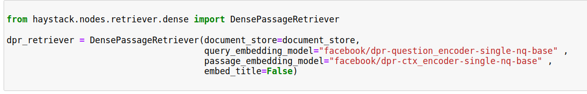
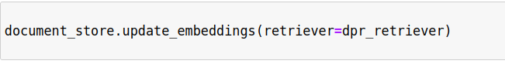
Dense Passage Retrieval (DPR)
These encoders are trained by giving them questions:
Relevant (positive) passages
Irrelevant (negative) passages
The goal is to learn that relevant question-passage pairs have a higher similarity.
set embed_title=False concatenating the document’s title like item_id doesn’t provide any additional information because we filter per product.
Initialized the dense retriever:

Slide 23
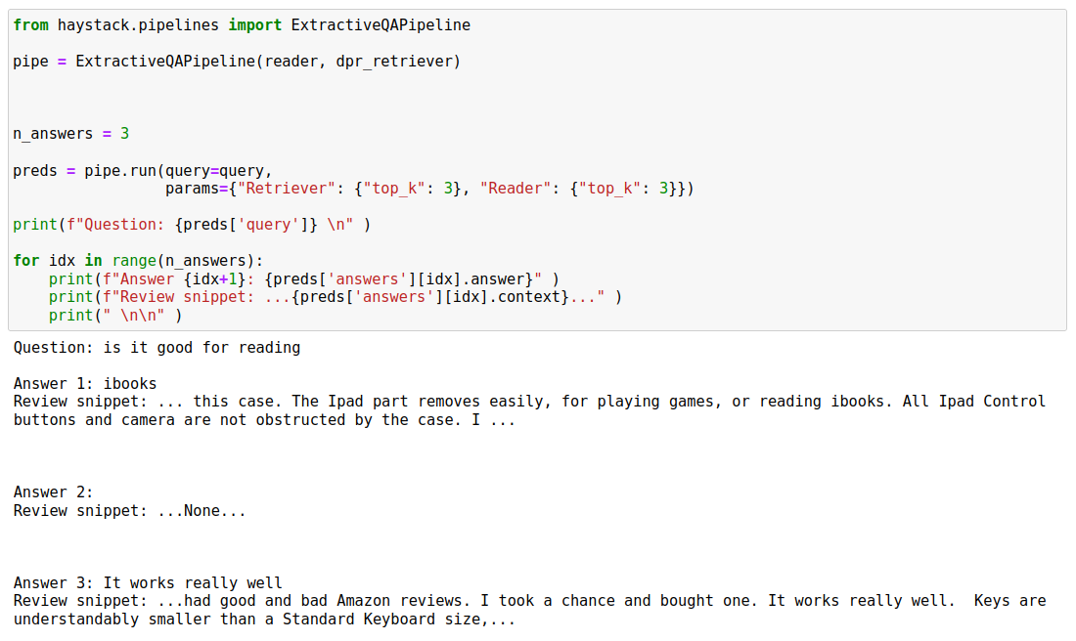
Dense Passage Retrieval (DPR)
Results: DPR method is not good as sparse method
Solution:
One of the solution is to choose another pretrained reader model like Roberta.
fine tune a pretrained model on your own dataset that is a great idea for domain adaption.
Not only the reader model but also you can fine tune the retriever model as well.

